Slide 1
Fake News Detection using machine learning
A 6th semester Project By HIMANSHU CHAND
B.Tech(CSE)/GEHU-DDN/1918375

Slide 2
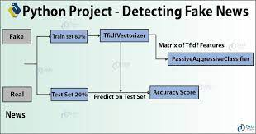
About the Project
The main purpose of this project is to build A Machine Learning Model which can differentiate between fake and real news with the help of dataset which gets updated frequently.
In this project, news database consisting of thousands of news will be created to make a dataset of good accuracy. After the receiving a dataset it will be pre-processed to remove stop words and get only unique words from news headline.
The next phase of pre-processing consist of converting textual data into the machine understandable numeric values with the help of Tfidvectorizer() function of sklearn library.
After the pre processing phase the machine is trained with the help of PassiveAgressiveClassifier Algorithm for given dataset.

Slide 3
Working of the project
The project works on 3 different steps in order to provide final output
1. Importing Dataset
To validate a news, firstly we need a big and accurate dataset because the accuracy of our model purely depends on the values presented in the dataset. The two main columns present in dataset are ‘Tittle’ and ‘label’ (FAKE/REAL) of each corresponding tittle.
2. Pre-processing Data
Once we got our dataset it’s time to remove unnecessary words (stop words) from the each news title. These stop words are commonly used words like ‘the’,’is’,’am’ etc. As they don’t really add any value to actual news we can safely remove them to make the headline containing the core words of tittle only. After that textual data is converted to their respective numeric values using Tfidvectorizer() function.
3. Training the machine
At last the model is tranined using the pre-processed dataset with Passive Aggressive Classifier algorithm. Later on the model is exported using ‘pickle’ python library with .pkl extension.

Slide 4
Understanding the terms
What is a TfidfVectorizer?
TF (Term Frequency): The number of times a word appears in a document is its Term Frequency. A higher value means a term appears more often than others, and so, the document is a good match when the term is part of the search terms.
IDF (Inverse Document Frequency): Words that occur many times a document, but also occur many times in many others, may be irrelevant. IDF is a measure of how significant a term is in the entire corpus.
The TfidfVectorizer converts a collection of raw documents into a matrix of TF-IDF features.
What is a PassiveAggressiveClassifier?
Passive Aggressive algorithms are online learning algorithms. Such an algorithm remains passive for a correct classification outcome, and turns aggressive in the event of a miscalculation, updating and adjusting. Unlike most other algorithms, it does not converge. Its purpose is to make updates that correct the loss, causing very little change in the norm of the weight vector.

Slide 5
Achievements and learnings
Through this project I have successfully completed my first project using Python Passive Aggressive classifier algorithm.
Working in this project has given me a well idea about implementation and working of different library modules like Pandas, NumPy, Pickle, Tfidfvectorizer etc.
While working in this project I got to know about how a csv file can be manipulated with the help of different requirements in python.
Just because of this project I got to know about how we can export our ML model to a external storage and use it in creating responsive website as well.
Apart from all challenges and problem, I learned how machine learning is enhancing and positively affecting our day to day life.

Slide 6

Screenshots of project

Slide 7
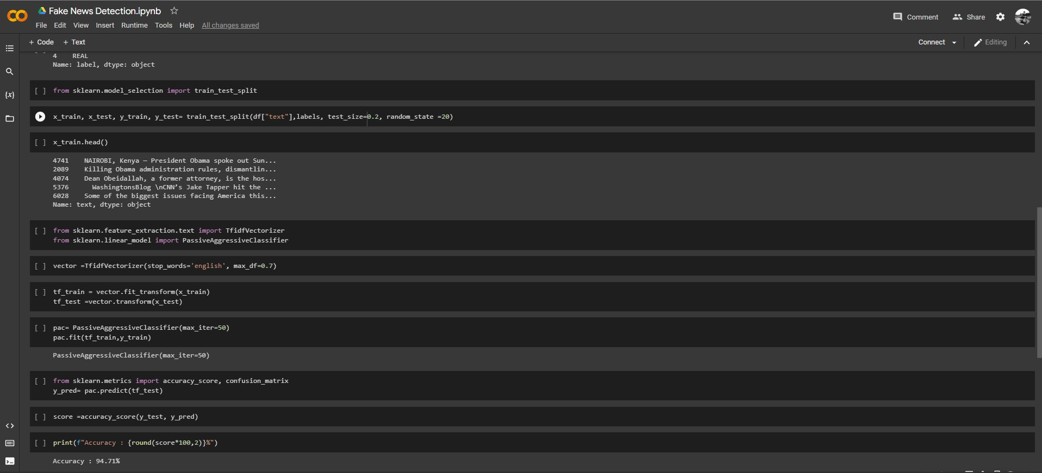
Screenshots of project
TAKUMA HAYASHI
MIRJAM NILSSON​
FLORA BERGGREN​
RAJESH SANTOSHI
President
Chief Executive Officer
Chief Operations Officer
VP Marketing
GRAHAM BARNES
ROWAN MURPHY
ELIZABETH MOORE
ROBIN KLINE
VP Product
SEO Strategist
Product Designer
Content Developer

Slide 8
Problems and challenges faced
One of the problems that I faced was getting an inaccurate dataset. Sometimes there are some news present in dataset which are contradicting one another . The dataset should always have ample amount of data present in order to achieve a good accuracy.
The news headline used in database shouldn’t be of much bigger size, as it will occupy more disk space and pre-processing of news headline with real time vectorizer will be more time taking and resource consuming too.
The another big challenge for me was to connect the model to the web UI using a python framework like ‘Flask’. Platforms like ‘stackoverflow’ helped a lot to me in resolving errors while connecting model with the website.

Slide 9
conclusion
In this way, a Machine learning algorithm (PassiveAggressiveClassifier) based automated Fake news prediction system is thoroughly described.
The accuracy of this proposed approach is 94.71%
As a conclusion for analysis, the extraction of Core words and tags could be challenging especially in different languages of news headlines.
The future scope of the project is connecting this methodology to the internet news which gives results even for the test data that is not present in the training data sets. We can even change to some other better classifier to classify the data other than PassiveAgressiveClassifier and Logistic Regression

Slide 10
THANK YOU
HIMANSHU CHAND
Section-A / section Roll:40
Uni Roll no:1918375
B.Tech(C.S.E)/ GEHU-DDN
+91-8126443582
himanshuchand38@gmail.com

